Slide 1
Module 7
Collections

Slide 2
Collection Framework
The Collection Framework in Java provides a set of interfaces and classes to work with groups of objects efficiently.
Collections need objects, they cannot store primitive types. Wrapper classes allow us to store primitive values in collections.
A Wrapper Class is a class in Java that provides an object representation for primitive data types.
Two main types of collections in Java are List and Map.

Slide 3
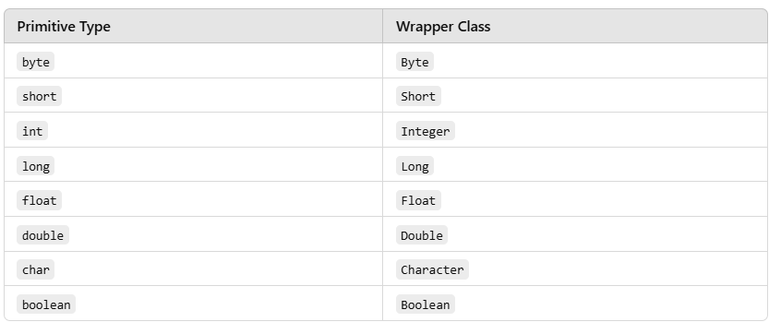
Wrapper Class

Slide 4
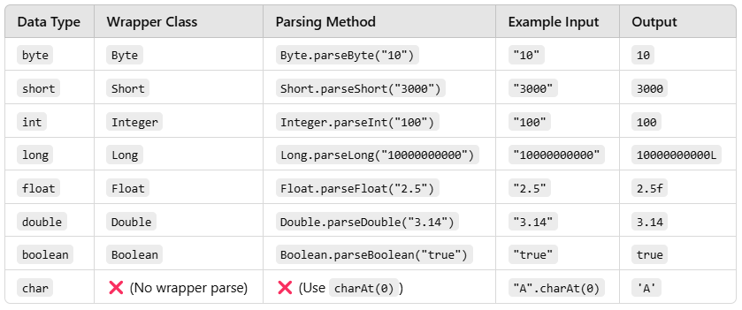
Methods
Wrapper classes provide useful methods for converting and manipulating values

Slide 5
1. List
A List maintains the insertion order and allows duplicate elements.
Elements can be accessed using an index.
Common implementations:
ArrayList
LinkedList

Slide 6
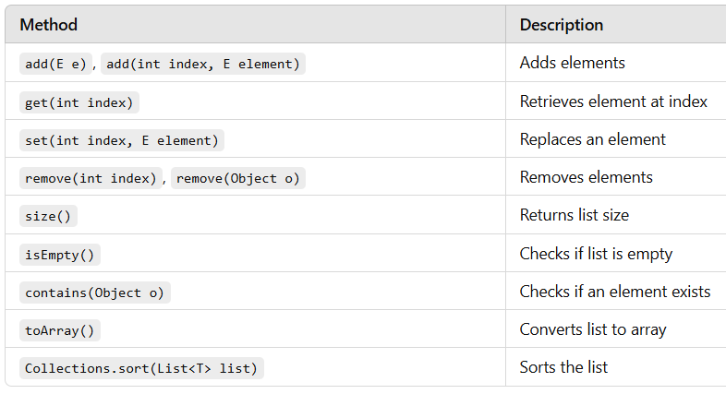

Slide 7
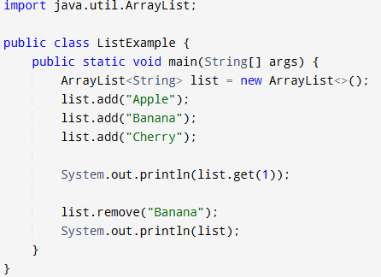
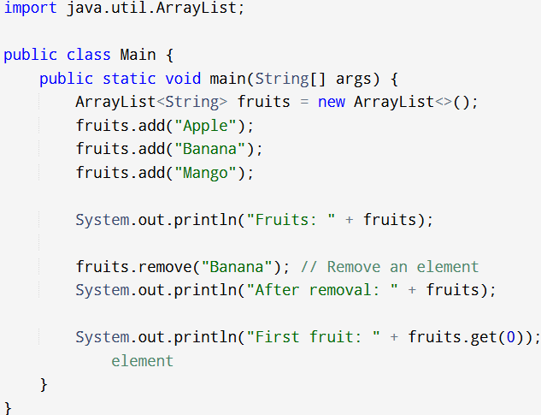
Example 1: ArrayList

Slide 8
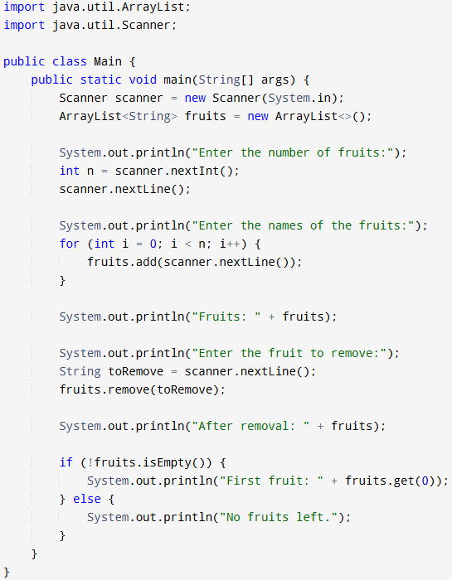
Example 2: ArrayList User-Input

Slide 9
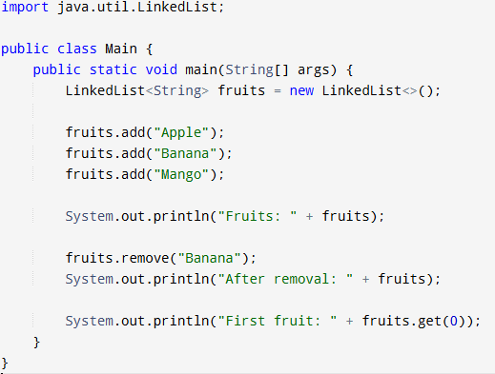
Example 1: LinkedList

Slide 10
2. Map
A Map stores elements in key-value pairs.
Keys are unique, but values can be duplicated.
Common implementations:
HashMap
HashSet
TreeMap
LinkedHashMap

Slide 11
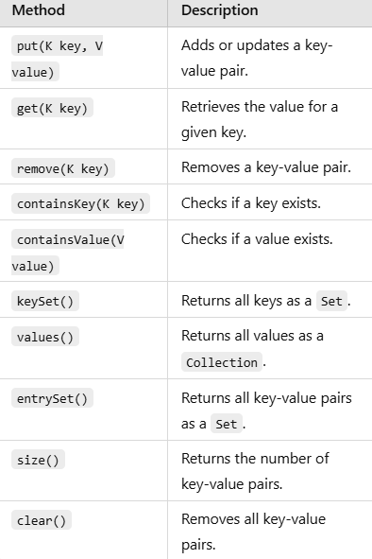

Slide 12
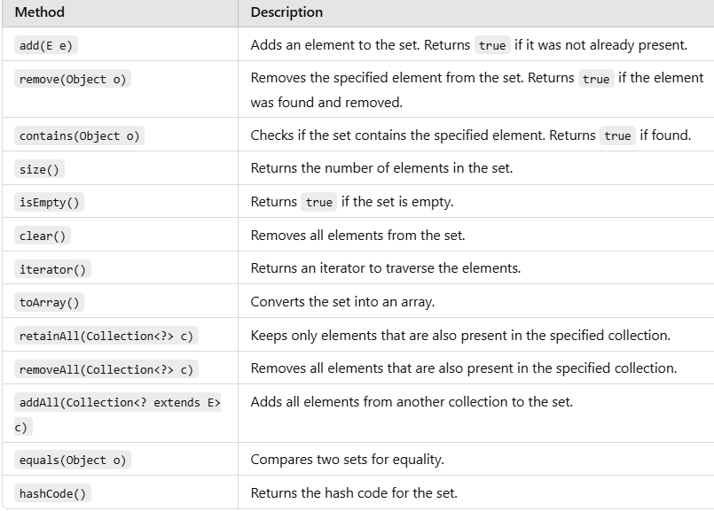

Slide 13
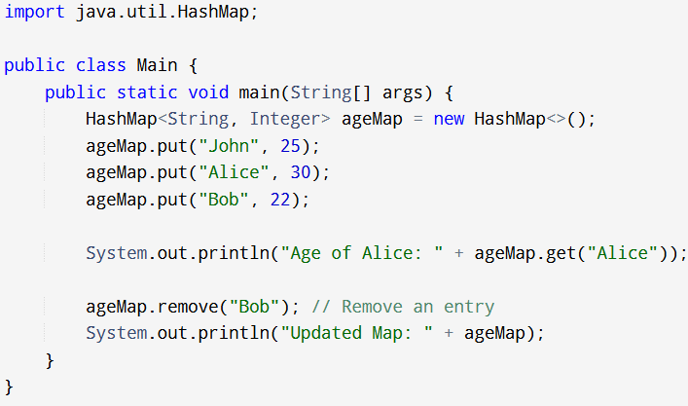
Hash Map Example

Slide 14
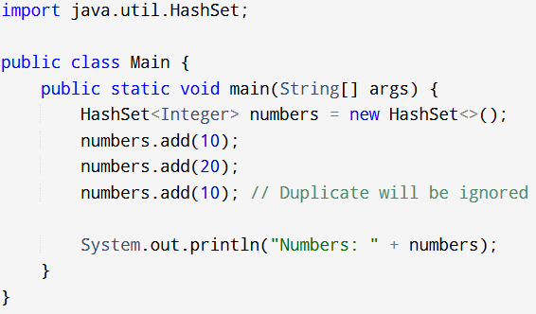
Hash Set Example

Slide 15
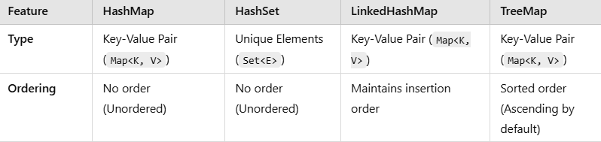
Comparison

